Slide 1


Slide 2
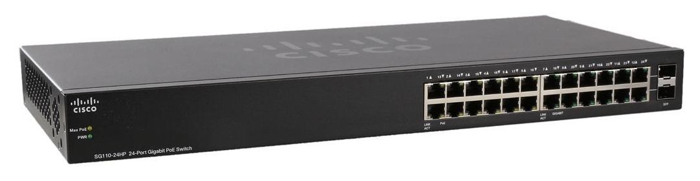


Virtual Local Area Network (VLAN)
A virtual LAN (VLAN) is a group of interfaces in the same broadcast domain
Two Major Functions of VLANs:
Below is a network with three different physical switches. The switches facilitate communication within networks, and the Routers facilitate communication between networks.
If each of these switches have 24 ports and only one is in use, then 23 ports are left wasted on each switch. Moreover, what if you need to replicate this network elsewhere and you do not have three physical switches to accommodate?
That is where the first major function of a VLAN comes into play: A VLAN allows you to take one physical switch, and break it up into smaller mini-switches.

Slide 3
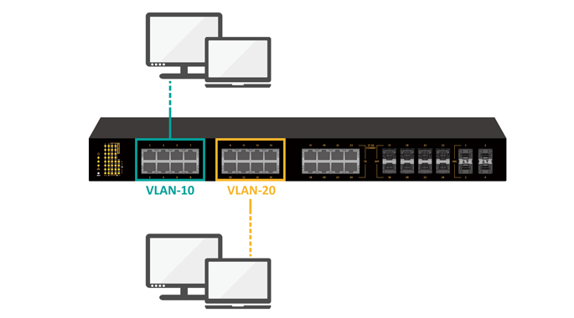
Virtual Local Area Network VLAN
Breaking up one Physical Switch into multiple Virtual Switches:
Consider each circle on the switch below as its own mini-switch (or virtual switch). Each of these mini-switches are a collection of switch ports which operate completely independent from the others — exactly as they would had there been three different physical switches.
Traffic flow through the single switch of this topology operates exactly as it did in the topology above it with three separate physical switches. The routers are configured and operate exactly as they did above.

Slide 4
Each virtual switch, or VLAN, is simply a number assigned to each switch port. For example, the two switch ports in the red mini-switch might be assigned to VLAN #10. The two ports in the orange mini-switch might be assigned to VLAN #20. And lastly the two switch ports in the blue mini-switch might be assigned to VLAN #30.
Any switch port which is not explicitly assigned a VLAN number, resides in the default VLAN. Which for most vendors corresponds to VLAN 1.
Traffic arriving on a switch port assigned to one VLAN will only ever be forwarded out another switch port that belongs to the same VLAN – a switch will never allow traffic to cross a VLAN boundary. Again, each VLAN operates as if it were a completely separate physical switch.
In the first illustration, traffic from the red switch cannot magically appear on the orange switch without first passing through a router. Similarly, in the second illustration, traffic in VLAN #10 cannot magically appear on VLAN #20 without also passing through a router.
When a frame arrives on a switchport in VLAN #10, it can only leave a switchport in VLAN #10. You and I can see that the same frame is traversing all three VLANs, but from the Switch’s perspective, it is three different instances of a frame arriving on one port in one VLAN, and leaving on another port in the same VLAN.

Slide 5
Assigning the Switchport to a VLAN:
Now that the VLAN is in the VLAN database, we can configure a switch port to be an access port for a particular VLAN. There are two commands within the interface configuration mode for this step:
SwitchX(config)# interface Ethernet 0/0
SwitchX(config-if)# switchport mode access
SwitchX(config-if)# switchport access vlan 10
SwitchX(config)# vlan 30
SwitchX(config-vlan)# name BLUE
The switchport mode access command sets the port as an access port, and the switchport access vlan <#> command designates the port as a member of VLAN 10.
In summary, the two steps to configure an access port:
Create and optionally (but ideally) name the VLAN
Set a switch port as an access port and designate it as a member of a VLAN
Both steps will also need to be accomplished for each VLAN and switch port on SwitchY. First we will create and name each VLAN:
SwitchY(config)# vlan 10 SwitchY(config-vlan)# name RED SwitchY(config-vlan)# exit SwitchY(config)# vlan 20 SwitchY(config-vlan)# name ORANGE SwitchY(config-vlan)# exit SwitchY(config)# vlan 30 SwitchY(config-vlan)# name BLUE SwitchY(config-vlan)# exit
SwitchY(config)# interface Ethernet 0/2 SwitchY(config-if)# switchport mode access SwitchY(config-if)# switchport access vlan 10 SwitchY(config-if)# exit SwitchY(config)# interface Ethernet 0/3 SwitchY(config-if)# switchport mode access SwitchY(config-if)# switchport access vlan 30 SwitchY(config-if)# exit

Slide 6
Access Ports
An access port is a switch port that is a member of only one VLAN. There are two parts to configuring an access port: creating the VLAN in the switch’s VLAN Database and assigning the switch port to a VLAN.
Creating the VLAN in the VLAN Database
Before a switch will accept or forward traffic for a VLAN, the VLAN must exist in the switch’s VLAN Database. Adding a VLAN to the VLAN database requires only one command:
SwitchX(config)# vlan 10
From this point, you can also optionally name the VLAN. While not explicitly necessary for traffic to flow, it is best practice to provide a name for each VLAN. This will make the VLAN easier to identify.
To name a VLAN, simply use the name; command directly after creating it.
SwitchX(config-vlan)# name RED
For VLAN 20, we will create and name the VLAN on SwitchX:
SwitchX(config)# vlan 20
SwitchX(config-vlan)# name ORANGE

Slide 7
Trunk Ports
a trunk port is a switch port that is carrying more than one VLAN.
Creating a trunk port involves only one command:
SwitchY(config)# interface Ethernet1/1
SwitchY(config-if)# switchport mode trunk
Just like switchport mode access set the port as an access port, switchport mode trunk will set the port as a trunk port.
By default, when an interface is set as a trunk port, traffic from all the VLANs in the VLAN database is forwarded out that switch port.
There are times, however, where it is wise to limit which VLAN’s traffic is traversing a particular trunk. This can be done by applying what is known as an Allowed VLAN list. An Allowed VLAN list allows the administrator to manually select which VLANs are traversing a trunk port.
SwitchX(config)# interface Ethernet 2/1
SwitchX(config-if)# switchport trunk allowed vlan 10,20
Without Trunk
With trunk

Slide 8
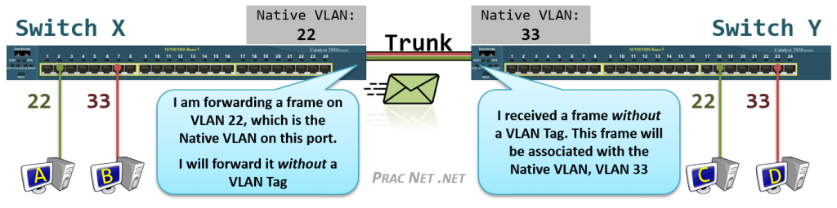
Native VLAN
The Native VLAN is the answer to how a switch processes traffic it receives on a Trunk port which does not contain a VLAN Tag. Without the tag, the switch will not know what VLAN the traffic belongs to, therefore the switch associates the untagged traffic with what is configured as the Native VLAN. Essentially, the Native VLAN is the VLAN that any received untagged traffic gets assigned to on a Trunk port.
Additionally, any traffic the switch forwards out a Trunk port that is associated with the Native VLAN is forwarded without a VLAN Tag.
The Native VLAN can be configured on any Trunk port. If the Native VLAN is not explicitly designated on a Trunk port, the default configuration of VLAN #1 is used.
That being said, it is crucially important that both sides of a Trunk port are configured with the same Native VLAN. This illustration explains why:
Above we have four Hosts (A, B, C, D) all connected to Access Ports in VLAN #22 or VLAN #33, and Switch X and Switch Y connected to each other with a Trunk port.
Host A is attempting to send a frame to Host C. When it arrives on the switch, Switch X associates the traffic with VLAN #22. When the frame is forwarded out Switch X’s Trunk port, no tag is added since the Native VLAN for the Trunk Port on Switch X is also VLAN #22.
But when the frame arrives on Switch Y without a tag, Switch Y has no way of knowing the traffic should belong to VLAN #22. All it can do is associate the untagged traffic with what Switch Y’s Trunk port has configured as the Native VLAN, which in this case is VLAN #33.
Since Switch Y will never allow VLAN #33 traffic to exit a VLAN #22 port, Host C will never get this traffic. Even worse, due to a Switch’s flooding behavior, Host D might inadvertently get the traffic that was destined to Host C.

Slide 9
Native VLAN continuation:
To set the Native VLAN, you use this command:
SwitchX(config)# interface Ethernet 1/1 SwitchX(config-if)# switchport trunk native vlan 2
After setting this command, any time SwitchX is sending traffic on VLAN 2 out the trunk port Eth1/1, it will do so without adding a VLAN tag. Moreover, anytime SwitchX receives untagged traffic on trunk port Eth1/1, SwitchX will assign that traffic to VLAN 2.
An important point to remember: both switches on either end of the same trunk must have the same Native VLAN. Otherwise, you easily run the risk of a host in one VLAN being able to communicate with a host in another VLAN.
Therefore, we will set the same Native VLAN on SwitchY:
SwitchY(config)# interface Ethernet 1/1 SwitchY(config-if)# switchport trunk native vlan 2
show vlan brief
show interfaces trunk
show interfaces switchport
show interfaces status
show spanning-tree

